Slide 1

Applied Survival Analysis in R
EDNA MWENDA

Slide 2

About Speaker
Edna Mwenda is a graduate with a BSc. Actuarial Science. A lover of music, plays the guitar and plays baseball.
Very passionate about R, Data science and tech for good.

Slide 3
Brief Introduction to Survival Analysis
Survival analysis is a collection of statistical procedures for data analysis where the outcome variable of interest is time until an event occurs.
Dating back to at least 1662 when John Graunt, a London merchant, published an extensive set of inferences based on mortality records, survival analysis is one of the oldest subfields of Statistics.

Slide 4
Applied survival analysis
Survival analysis models are important in Engineering, Insurance, Marketing, Medicine, and many more application areas.
It is also referred to as reliability analysis in engineering and time-to-event analysis.

Slide 5
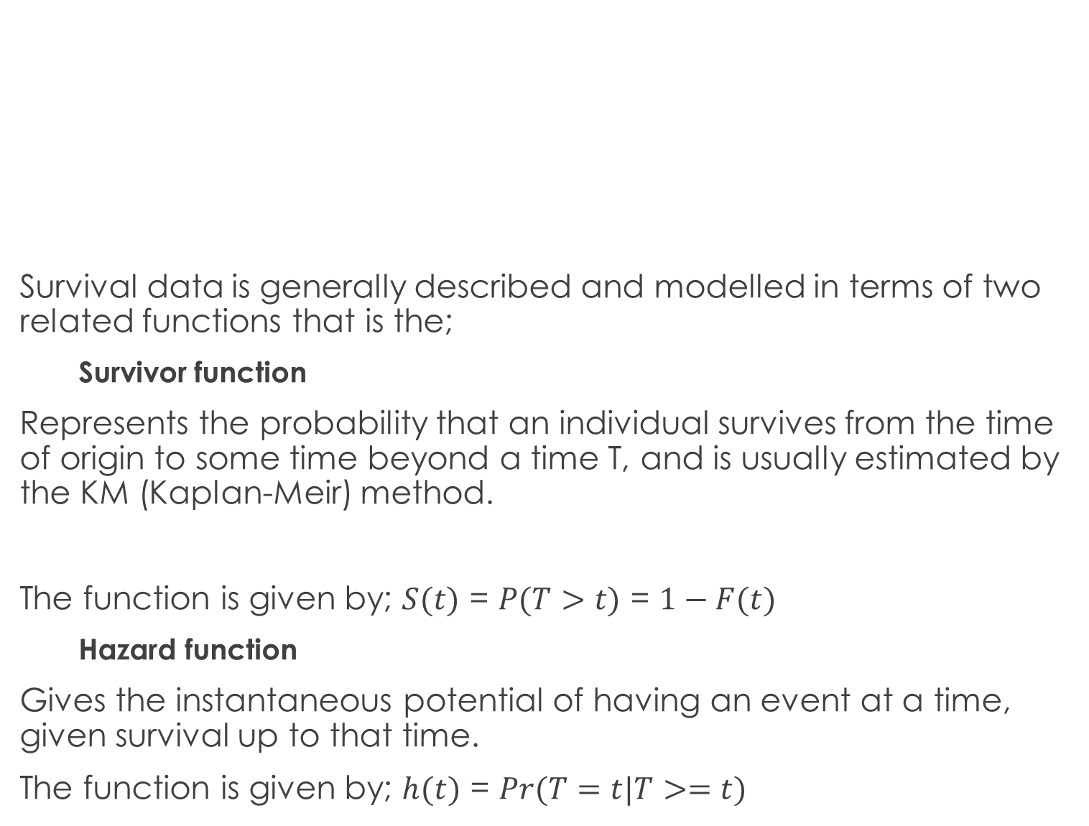
Survival data is generally described and modelled in terms of two related functions that is the;
Survivor function
Represents the probability that an individual survives from the time of origin to some time beyond a time T, and is usually estimated by the KM (Kaplan-Meir) method.
The function is given by; $S(t)$ = $P(T>t)$ = $1−F(t)$
Hazard function
Gives the instantaneous potential of having an event at a time, given survival up to that time.
The function is given by; $h(t)$ = $Pr(T=t|T>=t)$

Slide 6
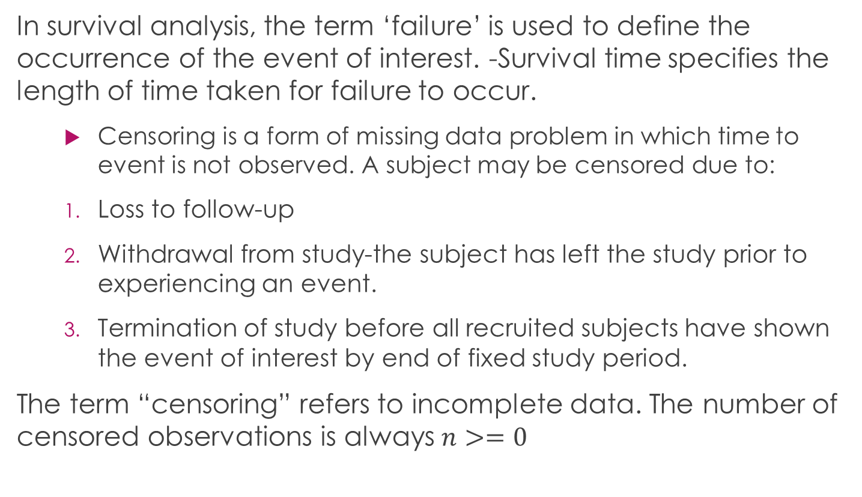
Definition of other terms used in survival analysis
In survival analysis, the term ‘failure’ is used to define the occurrence of the event of interest. -Survival time specifies the length of time taken for failure to occur.
Censoring is a form of missing data problem in which time to event is not observed. A subject may be censored due to:
Loss to follow-up
Withdrawal from study-the subject has left the study prior to experiencing an event.
Termination of study before all recruited subjects have shown the event of interest by end of fixed study period.
The term “censoring” refers to incomplete data. The number of censored observations is always $n>=0$

Slide 7
Types of censoring
1. Right censoring - occurs when a subject leaves the study before an event occurs or the study ends before the event has occurred. There are 3 types of right censoring;
Fixed type I censoring-occurs when failure hasn’t happened during the termination of the study period.
Random type I censoring- occurs during the study period and not at a fixed time i.e. completely random dropout (e.g. emigration).
Type II- study ends when a fixed pre-specified no. of events amongst the subjects has occurred.
2. Left censoring is when the event of interest has already occurred before enrolment. This is very rarely encountered.
3. Interval censoring- occurs if aa subject true but unobserved survival time is within a known time interval.

Slide 8
Objectives
To estimate/fit the Kaplan-Meier estimates of survival
To interpret the survivor estimates
To compare the distribution of survival times in different groups
To assess the relationship of the explanatory variable to the survival times

Slide 9
Non-parametric modelling of survival distribution
Here;
The distribution form of data is NOT necessary. We‘ll consider first of the three approaches;
Kaplan-Meier estimator of the survivor function
Nelson-Aalen estimator of the cumulative hazard
Actuarial estimator (life table estimator)

Slide 10
Case study | Methodology
Consider the (Ovarian cancer) dataset in the package ‘survival’.
## [1] 59 115 156 421+ 431 448+ 464 475 477+ 563 638 744+ 769+ 770+ 803+ 855+ ## [17] 1040+ 1106+ 1129+ 1206+ 1227+ 268 329 353 365 377+
The + behind the survival times represents censored data points at that time.

Slide 11
Estimating survival distribution using the Kaplan-Meier method
## Call: survfit(formula = Surv(futime, fustat) ~ 1, data = ovarian) ## ## time n.risk n.event survival std.err lower 95% CI upper 95% CI ## 1 26 0 1.000 0.0000 1.000 1 ## 5 26 0 1.000 0.0000 1.000 1 ## 10 26 0 1.000 0.0000 1.000 1 ## 20 26 0 1.000 0.0000 1.000 1 ## 40 26 0 1.000 0.0000 1.000 1 ## 60 25 1 0.962 0.0377 0.890 1 ## 80 25 0 0.962 0.0377 0.890 1 ## 100 25 0 0.962 0.0377 0.890 1 ## 120 24 1 0.923 0.0523 0.826 1 ## 140 24 0 0.923 0.0523 0.826 1 ## 160 23 1 0.885 0.0627 0.770 1 ## 180 23 0 0.885 0.0627 0.770 1 ## 200 23 0 0.885 0.0627 0.770 1

Slide 12

The Kaplan-Meier survival estimator
Kaplan-Meier estimate is a non-parametric maximum likelihood estimate (MLE) of the survival function, $S(t)$.
The Kaplan-Meier estimate is fit in R using the function survfit() in the survival function.

Slide 13
What happens when we add more variables?
## Call: survfit(formula = Surv(futime, fustat) ~ rx, data = data) ## ## n events median 0.95LCL 0.95UCL ## rx=1 13 7 638 268 NA ## rx=2 13 5 NA 475 NA
## Call: survfit(formula = Surv(futime, fustat) ~ rx, data = data) ## ## rx=1 ## time n.risk n.event survival std.err lower 95% CI upper 95% CI ## 59 13 1 0.923 0.0739 0.789 1.000 ## 115 12 1 0.846 0.1001 0.671 1.000 ## 156 11 1 0.769 0.1169 0.571 1.000 ## 268 10 1 0.692 0.1280 0.482 0.995 ## 329 9 1 0.615 0.1349 0.400 0.946 ## 431 8 1 0.538 0.1383 0.326 0.891 ## 638 5 1 0.431 0.1467 0.221 0.840 ## ## rx=2 ## time n.risk n.event survival std.err lower 95% CI upper 95% CI ## 353 13 1 0.923 0.0739 0.789 1.000 ## 365 12 1 0.846 0.1001 0.671 1.000 ## 464 9 1 0.752 0.1256 0.542 1.000 ## 475 8 1 0.658 0.1407 0.433 1.000 ## 563 7 1 0.564 0.1488 0.336 0.946
## Call: survfit(formula = Surv(futime, fustat) ~ rx, data = data) ## ## n events median 0.95LCL 0.95UCL ## rx=1 13 7 638 268 NA ## rx=2 13 5 NA 475 NA

Slide 14
Are the two survival functions statistically significant?
Using the log-rank/Mantel- Haenzel test to compare the survival times between groups
H0: Survival in two groups is same H1: Survival in two groups is not the same
## Call: ## survdiff(formula = Surv(futime, fustat) ~ rx, data = ovarian,
## rho = 0) ## N Observed Expected (O-E)^2/E (O-E)^2/V ## rx=1 13 7 5.23 0.596 1.06 ## rx=2 13 5 6.77 0.461 1.06 ## ## Chisq= 1.1 on 1 degrees of freedom, p= 0.3
We therefore conclude that, since there’s enough evidence at 5% significance level, we fail to reject the null hypothesis and that survival in the two groups of treatment is the same.

Slide 15
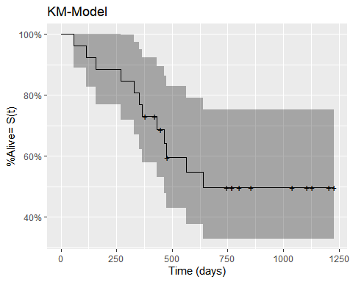
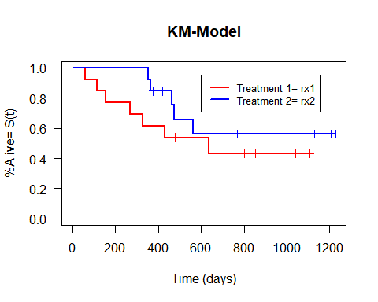
KM plots
The first plot shows the survival probabilities for the overall dataset, 2nd is for various treatments.

Slide 16
Cox Proportional Hazard Model
The Cox model, is a regression method for survival data, that provides an estimate of the hazard ratio and its confidence interval. The hazard ratio is an estimate of the ratio of the hazard rate in the treated versus the control group, commonly used statistical medical research for investigating the association between the survival time of patients and one or more predictor variables.
Next we’ll fix a cox PH model that makes use of the covariates in the dataset.

Slide 17
The cox PH model summary
## Call: ## coxph(formula = Surv(futime, fustat) ~ rx + ecog.ps + age, data = ovarian) ## ## n= 26, number of events= 12 ## ## coef exp(coef) se(coef) z Pr(>|z|) ## rx -0.8146 0.4428 0.6342 -1.285 0.1990 ## ecog.ps 0.1032 1.1087 0.6064 0.170 0.8649 ## age 0.1470 1.1583 0.0463 3.175 0.0015 ** ## --- ## Signif. codes: 0 '***' 0.001 '**' 0.01 '*' 0.05 '.' 0.1 ' ' 1 ## ## exp(coef) exp(-coef) lower .95 upper .95 ## rx 0.4428 2.2582 0.1278 1.535 ## ecog.ps 1.1087 0.9020 0.3378 3.639 ## age 1.1583 0.8633 1.0579 1.268 ## ## Concordance= 0.798 (se = 0.078 ) ## Likelihood ratio test= 15.92 on 3 df, p=0.001 ## Wald test = 13.32 on 3 df, p=0.004 ## Score (logrank) test = 18.7 on 3 df, p=3e-04

Slide 18
Interpretation of the cox model
Involves examining the coefficients of covariates.
A + regression coefficient means that the hazard is higher and thus the prognosis worse.
Since the cox measures the effect of the hazard rate, which is the risk of failure(% suffering event of interest), given that the participant has survived up to a certain time.

Slide 19
REFERENCES
[Analytics Vidhya] https://www.analyticsvidhya.com/blog/2014/04/solving-survival-model/
[NCBI] (https://www.ncbi.nlm.nih.gov/pmc/articles/PMC3059453/)
[Rstudio] (https://rviews.rstudio.com/2017/09/25/survival-analysis-with-r/)
[More] (https://stat.ethz.ch/R-manual/R-patched/library/survival/html/ovarian.html)

Slide 20
Thank youuu ::::☺!!!
Twitter: @Jeieddy
GitHub: EDNAMWENDA

